Slide 1
The Controller Components
The org.apache.struts.action.ActionServlet is the backbone of all Struts application.
It is the main Controller component that handles client request and determine which org.apache.struts.action.Action will process each request.
It is a simple servlet. Just like any other HTTP Servlet
It extends the class javax.servlet.http.HttpServlet and implements each of the HttpServelt’s lifecycle method, including the init(), doGet(), doPost(), and destroy() methods.
The source for both of these method is shown here :
public void doGet (HttpServletRequest request, HttpServeltResponse response)
throws IOException, ServletException
{
process(request,response);
}
public void doPost (HttpServletRequest request, HttpServeltResponse response)
throws IOException, ServletException
{
process(request,response);
}

Slide 2
The Controller Components
The Struts-specific behavior begins with this methods. The process() method handles all requests and has the following method signature:
protected void process (HttpServletRequest request, HttpServeltResponse response);
The Controller mechanism
  The doGet() or doPost() method receives a request and invoke the process method.
  The process() method get the current RequestProcessor and invoke the RequestProcessor.process() method.
  The RequestProcessor.process() method is where the current request is actually serviced. This method retrieves from the struts-config.xml file. The <action> element that matches the path submitted on the request. It does this by matching the path passed in the <html:form /> tag’s action element with the same path value.
  <html:form action=“/Lookup”>
  <action path=“/Lookup” type=“ch04.LookupAction” name=“lookupForm”>
  <forward name=“success” path=“/quate.jsp” />
  <forward name=“failure” path=“/index.jsp” />
  </action>

Slide 3
The Controller Components
The Controller mechanism
  When the RequestProcessor.process() method has a matching <action>, it looks for a <form-bean> entry that has a name attribute that matches the <action> element’s name attribute.
  <form-beans>
  <form-bean name=“lookupForm” type=“ch04.LookupForm” />
  </form-beans>
  <action path=“/Lookup” type=“ch04.LookupAction” name=“lookupForm”>
  <forward name=“success” path=“/quote.jsp” />
  <forward name=“failure” path=“index.jsp” />
  </action>
  When the RequestProcessor.process() method knows the fully qualified name of the FormBean, it creates or retrives a pooled instance of the ActionForm named by <form-bean> elemetn’s type attribure and populates its data member with the values submitted on the request.
  After the ActionForm’s data members are populated, the RequestProcessor.request() method calls the ActionForm.validate() method. Which checks the validity of the submitted values.

Slide 4
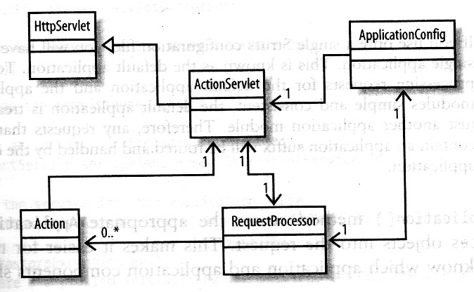
The Controller Components
The Controller mechanism
  Now it is time to service the request. It does this by retrieving the fully qualified name of the Action class from the <action> element’s type attribute, creating or retrieving the named class, and calling the Action.execute() method .
  When Action class returns from its processing , its execute() method returns an ActionForward object that is used to determine the target of this transaction. The RequestProcessor.process() method resume control, and the request is then forwarded to the determine target.
  At this point, the ActionServlet instance has completed its processing for this request and is ready to service future request.

